Slide 1
N-gram Language Modeling
Introduction to N-gram Language Models

Slide 2
Predicting words
Sentence: "The cat sat on the ______."
Prediction: "mat."
Sentence: "She decided to bake a chocolate ______."
Prediction: "cake."
Sentence: "After a long day at work, he enjoyed a nice cup of ______."
Possible Predictions:
"coffee."
"hot chocolate."
"water."

Slide 3
Language Models
Systems that can predict upcoming words
Can assign a probability to each potential next word
Can assign a probability to a whole sentence

Slide 4
probability to each potential next word
these words might be ranked in terms of likelihood based on common usage and context:
Sentence: "After a long day at work, he enjoyed a nice cup of ______."
"coffee." - 0.60 (Most likely, as many people enjoy coffee after work.)
"hot chocolate." - 0.25 (A popular choice, especially in colder weather.)
"water." - 0.15 (A common beverage, but less likely in the context of a comforting drink after work.)
These probabilities are illustrative and would vary based on the specific context and the model used for prediction.

Slide 5
Why word prediction?
It's a helpful part of language tasks
Grammar or spell checking
Their are two midterms Their There are two midterms
Everything has improve Everything has improve improved
Speech recognition
Sentence: "I scream for ice cream."
Phonetic Twist: "I scream for I dream."

Slide 6
Why word prediction?
It's how large language models (LLMs) work!
LLMs are trained to predict words
Left-to-right (autoregressive) LMs learn to predict next word
LLMs generate text by predicting words
By predicting the next word over and over again

Slide 7
Language Modeling (LM) more formally
Goal: compute the probability of a sentence or sequence of words W:
P(W) = P(w₁,w₂,w₃,w₄,w₅…w_{n})
Related task: probability of an upcoming word:
P(w₅|w₁,w₂,w₃,w₄) or P(w_{n}|w₁,w₂…w_{n-1})
An LM computes either of these:
P(W) or P(w_{n}|w₁,w₂…w_{n-1})

Slide 8
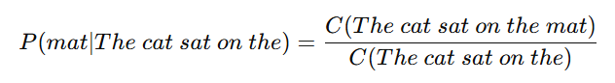
How to estimate these probabilities
Could we just count and divide?
No! Too many possible sentences!
We’ll never see enough data for estimating these

Slide 9
How to compute P(W) or P(w_{n}|w₁, …w_{n-1})
How to compute the joint probability P(W):
P(The, cat, sat, on, the, mat)
Intuition: let’s rely on the Chain Rule of Probability

Slide 10
Reminder: The Chain Rule
Recall the definition of conditional probabilities
P(B|A) = P(A,B)/P(A) Rewriting: P(A,B) = P(A) P(B|A)
More variables:
P(A,B,C,D) = P(A) P(B|A) P(C|A,B) P(D|A,B,C)
The Chain Rule in General
P(x₁,x₂,x₃,…,x_{n}) = P(x₁)P(x₂|x₁)P(x₃|x₁,x₂)…P(x_{n}|x₁,…,x_{n-1})

Slide 11
The Chain Rule applied to compute joint probability of words in sentence
P(“The cat sat on the mat”) =
P(The) × P(cat|The) × P(sat|The cat)
× P(on|The cat sat) × P(the|The cat sat on)
× P(mat|The cat sat on the)

Slide 12
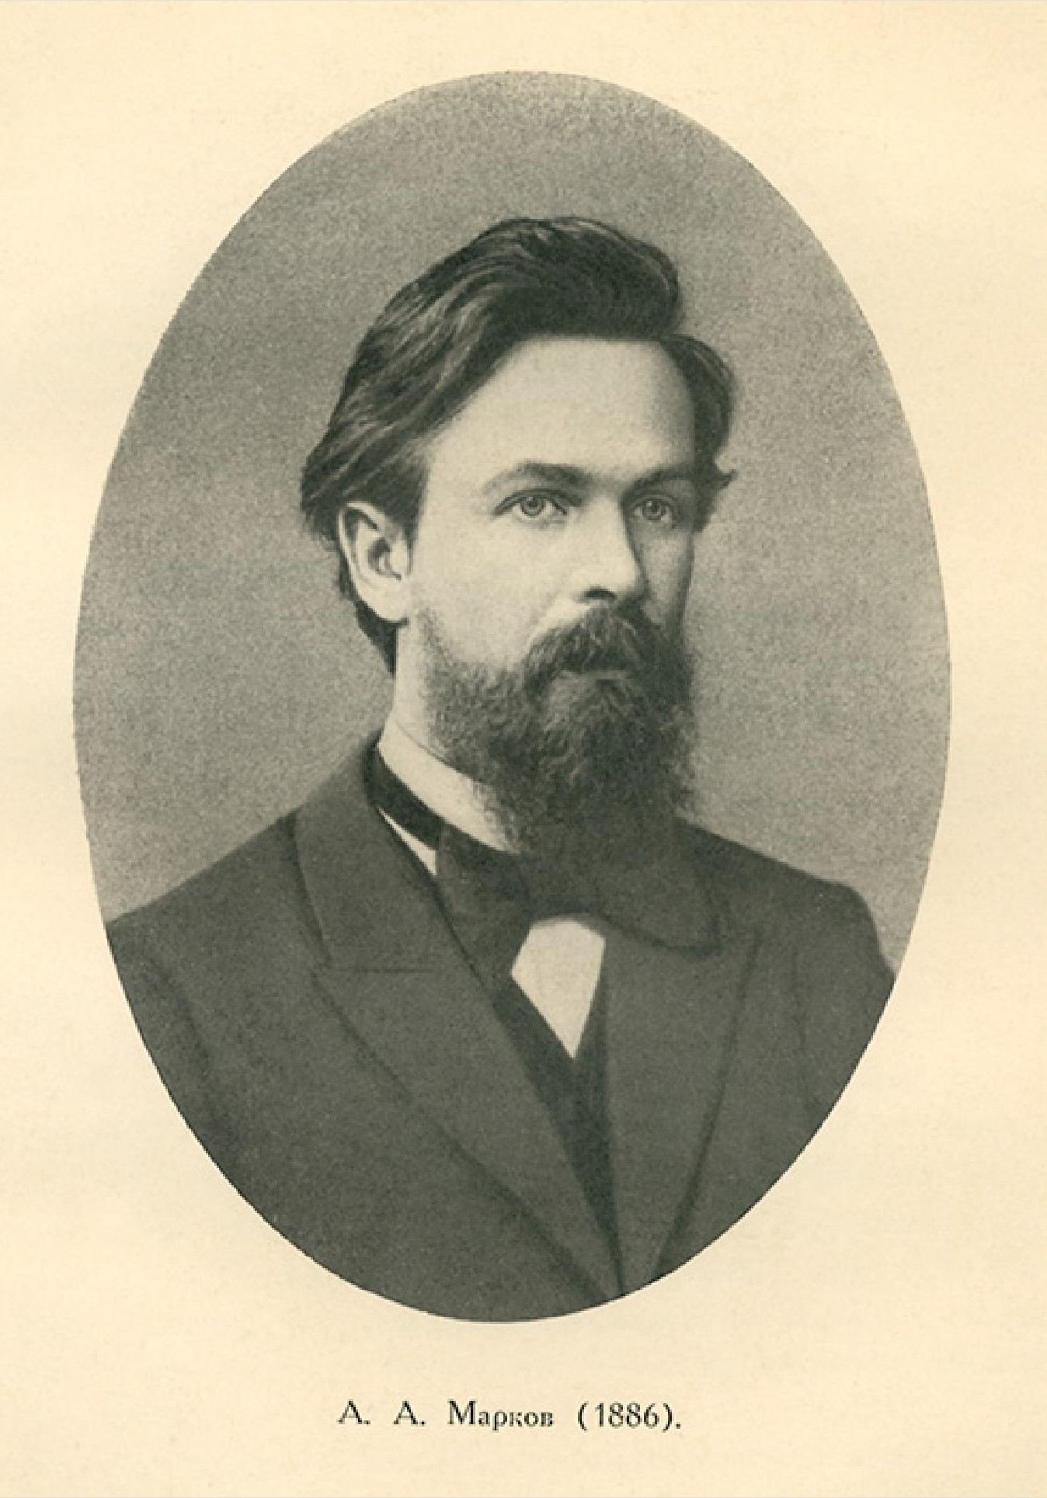
Markov Assumption
Simplifying assumption:
Andrei Markov
P(mat|The cat sat on the) ≈ P(mat|the)
Wikimedia commons

Slide 13
Bigram Markov Assumption
Instead of:
More generally, we approximate each component in the product

Slide 14
Simplest case: Unigram model
Some automatically generated sentences from two different unigram models
To him swallowed confess hear both . Which . Of save on trail for are ay device and rote life have
Hill he late speaks ; or ! a more to leg less first you enter
Months the my and issue of year foreign new exchange’s September
were recession exchange new endorsed a acquire to six executives

Slide 15
Bigram model
Some automatically generated sentences rom two different unigram models
Why dost stand forth thy canopy, forsooth; he is this palpable hit the King Henry. Live king. Follow.
What means, sir. I confess she? then all sorts, he is trim, captain.
Last December through the way to preserve the Hudson corporation N. B. E. C. Taylor would seem to complete the major central planners one gram point five percent of U. S. E. has already old M. X. corporation of living
on information such as more frequently fishing to keep her

Slide 16
Problems with N-gram models
N-grams can't handle long-distance dependencies:
“The soups that I made from that new cookbook I bought yesterday were amazingly delicious."
N-grams don't do well at modeling new sequences with similar meanings
The solution: Large language models
can handle much longer contexts
because of using embedding spaces, can model synonymy better, and generate better novel strings

Slide 17
Why N-gram models?
A nice clear paradigm that lets us introduce many of the important issues for large language models
training and test sets
the perplexity metric
sampling to generate sentences
ideas like interpolation and backoff

Slide 18
N-gram Language Modeling
Introduction to N-grams

Slide 19
N-gram Language Modeling
Estimating N-gram Probabilities

Slide 20
Estimating bigram probabilities
The Maximum Likelihood Estimate

Slide 21
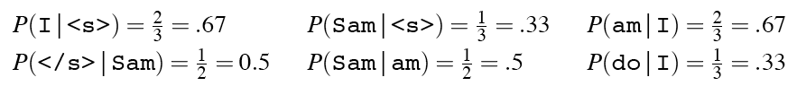
An example
<s> I am Sam </s>
<s> Sam I am </s>
<s> I do not like green eggs and ham </s>

Slide 22
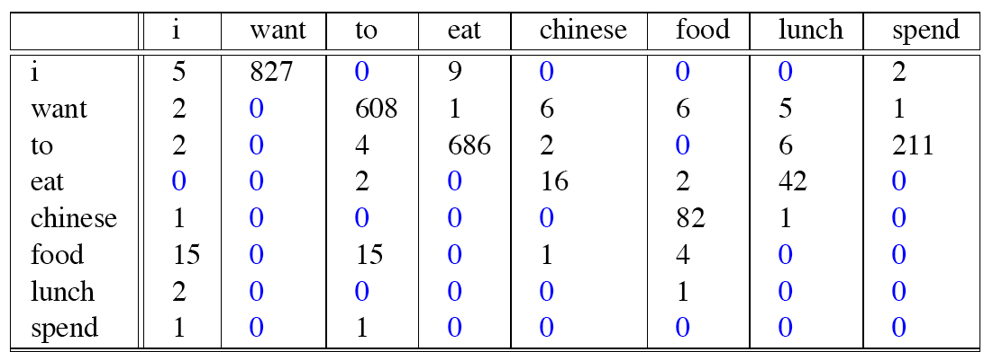
Raw bigram counts
Out of 9222 sentences

Slide 23
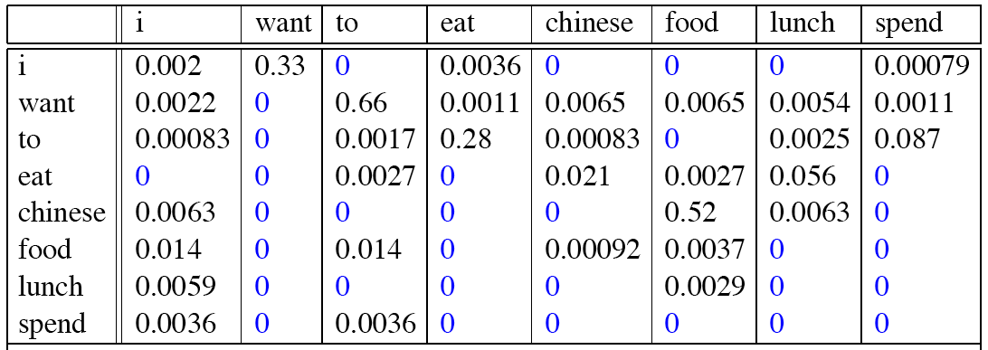
Raw bigram probabilities
Normalize by unigrams:
Result:

Slide 24
Bigram estimates of sentence probabilities
P(<s> I want english food </s>) =
P(I|<s>)
× P(want|I)
× P(english|want)
× P(food|english)
× P(</s>|food)
= .000031

Slide 25
What kinds of knowledge do N-grams represent?
P(english|want) = .0011
P(chinese|want) = .0065
P(to|want) = .66
P(eat | to) = .28
P(food | to) = 0
P(want | spend) = 0
P (i | <s>) = .25

Slide 26
Dealing with scale in large n-grams
LM probabilities are stored and computed in log format, i.e. log probabilities
This avoids underflow from multiplying many small numbers
If we need probabilities we can do one exp at the end

Slide 27
Larger ngrams
4-grams, 5-grams
Large datasets of large n-grams have been released
N-grams from Corpus of Contemporary American English (COCA) 1 billion words (Davies 2020)
Google Web 5-grams (Franz and Brants 2006) 1 trillion words)
Efficiency: quantize probabilities to 4-8 bits instead of 8-byte float
Newest model: infini-grams (∞-grams) (Liu et al 2024)
No precomputing! Instead, store 5 trillion words of web text in suffix arrays. Can compute n-gram probabilities with any n!

Slide 28
N-gram LM Toolkits
SRILM
http://www.speech.sri.com/projects/srilm/
KenLM
https://kheafield.com/code/kenlm/

Slide 29
N-gram Language Modeling
Estimating N-gram Probabilities

Slide 30
Language Modeling
Evaluation and Perplexity
Notes:
Language models, like all NLP tools, need to be evaluated. Here we introduce the standard evaluation tools for ngram language models as well as large language models: training sets, test sets, and the perplexity metric.

Slide 31
How to evaluate N-gram models
"Extrinsic (in-vivo) Evaluation"
To compare models A and B
Put each model in a real task
Machine Translation, speech recognition, etc.
Run the task, get a score for A and for B
How many words translated correctly
How many words transcribed correctly
Compare accuracy for A and B
Notes:
The best way to evaluate any NLP component like an N-gram language model is called extrinsic or in-vivo evaluation, meaning a live or real application. If we have two models, A, and B, that we want to evaluate, we put each in a real task that we care about, run the task, get a score for each of the two language models, such as the number of words translated or transcribed correctly, and then we just compare the scores or accuracies.

Slide 32
Intrinsic (in-vitro) evaluation
Extrinsic evaluation not always possible
Expensive, time-consuming
Doesn't always generalize to other applications
Intrinsic evaluation: perplexity
Directly measures language model performance at predicting words.
Doesn't necessarily correspond with real application performance
But gives us a single general metric for language models
Useful for large language models (LLMs) as well as n-grams
Notes:
Extrinsic evaluation isn't always possible. It's often time-consuming and expensive to run real tasks, involving human scoring, but that's a problem because we often want to evaluate thousands of versions of our systems. Also, we might want to see how well our n-gram language model works more generally, and not just in a particular application. For this reason, we often use an intrinsic, or in-vitro evaluation metric called perplexity. We call it intrinsic or in-vitro because it's not embedded in a real application in the world, so it's sort of a test-tube evaluation. Perplexity directly measuring language model performance at predicting words. This may not always correspond with real application performance, but it gives us a single general metric. We use perplexity for simple n-gram language models but also for the most advanced neural Large Language Models.

Slide 33
Training sets and test sets
We train parameters of our model on a training set.
We test the model’s performance on data we haven’t seen.
A test set is an unseen dataset; different from training set.
Intuition: we want to measure generalization to unseen data
An evaluation metric (like perplexity) tells us how well our model does on the test set.
Notes:
To evaluate, we'll need some data. We always train the parameters of our model, like the n-gram counts, on a training set. And we test the model's performance on data we haven't seen. A test set is an unseen dataset that is different from our training set, no part of it should have been used in training. The intuition is that we care about generalization of our model. A machine learning model that perfectly captured the training data, but doesn't generalize well to unseen data, wouldn't be much use! And then we'll need an evaluation metric, like perplexity, that tells us how well our model does on the test set.

Slide 34
Choosing training and test sets
If we're building an LM for a specific task
The test set should reflect the task language we want to use the model for
If we're building a general-purpose model
We'll need lots of different kinds of training data
We don't want the training set or the test set to be just from one domain or author or language.
Notes:
How do we create a training set? Sometimes we're building an LM for a specific task, like legal language or medical language, and then the test set should reflect the task that we care about. Other times, we're building a general-purpose language model, and then we'll want to make sure we get balanced data from lots of different genres and authors. And of course lots of data from many different languages, if we're building a multilingual LM.

Slide 35
Training on the test set
We can’t allow test sentences into the training set
Or else the LM will assign that sentence an artificially high probability when we see it in the test set
And hence assign the whole test set a falsely high probability.
Making the LM look better than it really is
This is called “Training on the test set”
Bad science!
Notes:
Again, the test set and the training set must be non-overlapping. If we have a test sentence in the training set, the n-gram (or any other language model) will learn which words follow which words in that sentence, and then when we see it in the test set, we will assign it a very probabilkity, and that will falsely make the language model seem more accurate than it is. Training on the test set is always a bad idea. It seems obvious, but it requires a lot of dataset care to keep this from happening, since often we get duplicate documents in our dataset, and one might find its way into the training set, and one into the test set.

Slide 36
Dev sets
If we test on the test set many times we might implicitly tune to its characteristics
Noticing which changes make the model better.
So we run on the test set only once, or a few times
That means we need a third dataset:
A development test set or, devset.
We test our LM on the devset until the very end
And then test our LM on the test set once
Notes:
Even a test set isn't enough. If we keep adjusting our LM, re-testing it on the same test set, we will implicitly be tuning it to the test set, improving it in ways that are fit too exactly to that particularly test set. So we try to reserve the test set to just run once or twice. Thus we'll need an intermediate test set to use while we are developing. That test set is hence called the development testset or devset.

Slide 37
Intuition of perplexity as evaluation metric: How good is our language model?
Intuition: A good LM prefers "real" sentences
Assign higher probability to “real” or “frequently observed” sentences
Assigns lower probability to “word salad” or “rarely observed” sentences?
Notes:
Let's now turn to the perplexity metric. The intuition of perplexity is that a good language model should prefer reall, or frequently observed sentences, and assign lower probably to rarely observed sentences, or just random sequences of words that we might call "word salad".

Slide 38
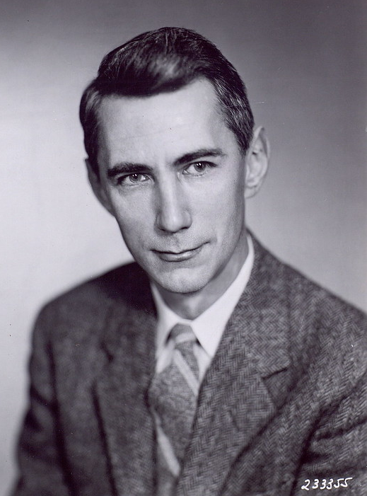
Intuition of perplexity 2: Predicting upcoming words
time 0.9
dream 0.03
midnight 0.02
…
and 1e-100
The Shannon Game: How well can we predict the next word?
Once upon a ____
That is a picture of a ____
For breakfast I ate my usual ____
Unigrams are terrible at this game (Why?)
Claude Shannon
A good LM is one that assigns a higher probability to the next word that actually occurs
Picture credit: Historiska bildsamlingen
https://creativecommons.org/licenses/by/2.0/
Notes:
We can think of this predicting task first just for individual words. The idea of asking an LM, or a person, to look at the start of a sentence, and predict the next upcoming word is called the Shannon Game, because it was invented by information theorist Claude Shannon in 1951 as a way of measuring the entropy of English. So if we see the prefix "Once upon a", we might guess "time" as a very likely next word, and maybe we would assign dream, or midnight as possible but less likely, while words like "and" should be extremely unlikely, because "Once upon a and" is an unlikely sentence. People are pretty good at this, as are language models, the longer the better. Unigrams are terrible at this time. Think about why this is? intuition of perplexity is that a good LM is one that is good at the Shannon game: it assigns a higher probability to the next word that actually occurs

Slide 39
Intuition of perplexity 3: The best language model is one that best predicts the entire unseen test set
We said: a good LM is one that assigns a higher probability to the next word that actually occurs.
Let's generalize to all the words!
The best LM assigns high probability to the entire test set.
When comparing two LMs, A and B
We compute P_{A}(test set) and P_{B}(test set)
The better LM will give a higher probability to (=be less surprised by) the test set than the other LM.
Notes:
Let's generalize this idea that a good LM assigns a higher probability to the next word that actually occurs, to say that A good LM assigns high probability to the entire test set. Let's just think of the test set as if it was one very long sentence. So when comparing to LMs, A, and B, we ask each to tell us the probability of the entire testset. Now the better LM is the one that gives a higher probability to the test set, or in other words is less surprised by the test set than the other LM.

Slide 40
Intuition of perplexity 4: Use perplexity instead of raw probability
Probability depends on size of test set
Probability gets smaller the longer the text
Better: a metric that is per-word, normalized by length
Perplexity is the inverse probability of the test set, normalized by the number of words
Notes:
There's a problem with using probability. And that is that the probability of a test set depends very directly on the length of the test set. This is because probability gets smaller the longer the text. For n-gram models, this is very clear; the chain rule of probability means that for a test set of N words we are multiplying together N n-gram probabilities! It would be better to normalize the probabilities by length to get a metric that is per-word. Perplexity is just such a metric. Perplexity is the inverse probability of the test set, normalized by the number of words. We normalize by taking the N-th root of the probability of the test set.

Slide 41
Intuition of perplexity 5: the inverse
Perplexity is the inverse probability of the test set, normalized by the number of words
(The inverse comes from the original definition of perplexity from cross-entropy rate in information theory)
Probability range is [0,1], perplexity range is [1,∞]
Minimizing perplexity is the same as maximizing probability
Notes:
Notice that I slipped something in there. Perplexity isjust just the probability of the test set normalized by the number of words. It's the inverse probability. There is this little minus-sign here, or a 1/x here. This inverse turns out to come from part of the original definition of perplexity from the idea of cross-entropy rate in information theory. We won't go into that here, but you can look at it in the textbook). We'll just say that because of that inverse, minimizing perplexity is the same as maximizing probability. So the better LM has a higher probability but a lower perplexity on the test set.

Slide 42
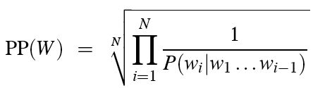
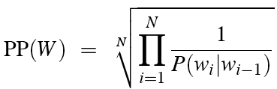
Intuition of perplexity 6: N-grams
Chain rule:
Bigrams:
Notes:
Let's see perplexity with n-gram language models. We can use the chain rule to turn the probability of the entire test set into N separate probabilities. Now we can make the n-gram assumption, such as the bigram simplification, to help us compute each of these individual probabilities.

Slide 43
Intuition of perplexity 7: Weighted average branching factor
Perplexity is also the weighted average branching factor of a language.
Branching factor: number of possible next words that can follow any word
Example: Deterministic language L = {red,blue, green}
Branching factor = 3 (any word can be followed by red, blue, green)
Now assume LM A where each word follows any other word with equal probability ⅓
Given a test set T = "red red red red blue"
Perplexity_{A}(T) = P_{A}(red red red red blue)^{-1/5} =
But now suppose red was very likely in training set, such that for LM B:
P(red) = .8 p(green) = .1 p(blue) = .1
We would expect the probability to be higher, and hence the perplexity to be smaller:
Perplexity_{B}(T) = P_{B}(red red red red blue)^{-1/5}
((⅓)⁵)^{-1/5}
= (⅓)⁻¹
=3
= (.8 * .8 * .8 * .8 * .1) ^{-1/5}
=.04096 ^{-1/5}
= .527⁻¹
= 1.89
Notes:
Finally, perplexity turns out to also correspond to the weigthed average branching factor of a language. The Branching factor of a language is the number of possible next words that can follow any word.

Slide 44
Holding test set constant: Lower perplexity = better language model
Training 38 million words, test 1.5 million words, WSJ
N-gram Order | Unigram | Bigram | Trigram
Perplexity | 962 | 170 | 109
Notes:
So if we hold the test set constant, the better, more predictive the language model, the lower the perplexity will be. Here we can see this with some text from the US Wall Street Journal newspaper text corpus. A unigram LM has a perplexity of 962, a bigram of 170, and a trigram of 109. The better the model, the higher the probability it assigns to the test set, and since perplexity goes inversely with probability, lower the perplexity.

Slide 45
Language Modeling
Evaluation and Perplexity
Notes:
You now have seen the perplexity metric which is central to language modeling, since we use it to evaluate LMs from n-grams to the most powerful neural large language models. And you've learned the concepts of training, dev, and test sets that we'll use for every supervised machine learning NLP algorithm.

Slide 46
Language Modeling
Sampling and Generalization
Notes:
In this lecture we introduce the idea of sampling from a language model: generating sentences according to their probabilities, and see how this allows us to talk about how well the language model generalizes (or doesn't) from its training data.

Slide 47
The Shannon (1948) Visualization Method Sample words from an LM
Claude Shannon
Unigram:
REPRESENTING AND SPEEDILY IS AN GOOD APT OR COME CAN DIFFERENT NATURAL HERE HE THE A IN CAME THE TO OF TO EXPERT GRAY COME TO FURNISHES THE LINE MESSAGE HAD BE THESE.
Bigram:
THE HEAD AND IN FRONTAL ATTACK ON AN ENGLISH WRITER THAT THE CHARACTER OF THIS POINT IS THEREFORE ANOTHER METHOD FOR THE LETTERS THAT THE TIME OF WHO EVER TOLD THE PROBLEM FOR AN UNEXPECTED.
Notes:
One important way to visualize what kind of knowledge a language model embodies is to sample from it. Sampling from a distribution means to choose random points according to their likelihood. Sampling from a language model means to generate sentence according to their likelihoods as defined by the model. Thus we are more likely to generate sentences that the model thinks have a high probability and less likely to generate sentences that the model thinks have a low probability. Here are some sentences generated by Claude Shannon in 1948 from a unigram and a bigram model. You can see that the unigram model is just word salad, but the bigram model, while still pretty random, it starting to look a bit more coherent in its sequences, at least locally.

Slide 48

How Shannon sampled those words in 1948
"Open a book at random and select a letter at random on the page. This letter is recorded. The book is then opened to another page and one reads until this letter is encountered. The succeeding letter is then recorded. Turning to another page this second letter is searched for and the succeeding letter recorded, etc."
Notes:
Here's how Shannon sampled those words in 1948, although describing the process for letters rather than words. How could we implement the same process computationally given an n-gram language model?

Slide 49
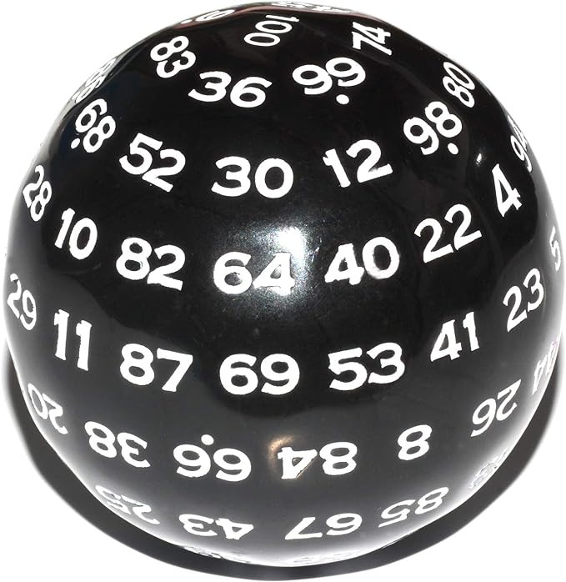
Sampling a word from a distribution
Notes:
It’s simplest to visualize how this works for the unigram case. Imagine all the words of the English language covering the probability space between 0 and 1, each word covering an interval proportional to its frequency. We choose a random value between 0 and 1, find that point on the probability line, and print the word whose interval includes this chosen value. So let's suppose we choose a random number, it's 0.12, we look on our number line, and that's the word "to", so we generate "to" as the next word. We continue choosing random numbers and generating words until we randomly generate the end-of-sentence token.

Slide 50
Visualizing Bigrams the Shannon Way
Choose a random bigram (<s>, w)
according to its probability p(w|<s>)
Now choose a random bigram (w, x) according to its probability p(x|w)
And so on until we choose </s>
Then string the words together
<s> I
I want
want to
to eat
eat Chinese
Chinese food
food </s>
I want to eat Chinese food
Notes:
We can extend this idea to n-grams. For example for the bigram case, we first choose a random bigram whose first token is the start-of-sentence token, according to its probability

Slide 51
Note: there are other sampling methods
Used for neural language models
Many of them avoid generating words from the very unlikely tail of the distribution
We'll discuss when we get to neural LM decoding:
Temperature sampling
Top-k sampling
Top-p sampling
Notes:
There are other, more sophisticated sampling algorithms, that we'll discuss when we get to neural language model decoding, methods like temperature or top-k sampling. They are mainly used to avoid generating really really rare words.

Slide 52
Approximating Shakespeare
Notes:
This figure shows some random sentences generated from unigram, bigram, trigram, and 4- gram models trained on the works of William Shakespeare.
The longer the context, the more coherent the sentences. In these unigram sentences, there's no coherent relation between words. The bigram sentences have some local word-to-word coherence, and sensible punctuation. The 3 and 4-gram sentences are beginning to look a lot like Shakespeare. In fact, they look a little too much like Shakespeare. The words It cannot be but so are directly from King John.

Slide 53
Shakespeare as corpus
N=884,647 tokens, V=29,066
Shakespeare produced 300,000 bigram types out of V²= 844 million possible bigrams.
So 99.96% of the possible bigrams were never seen (have zero entries in the table)
That sparsity is even worse for 4-grams, explaining why our sampling generated actual Shakespeare.
Notes:
Just choosing one author, Shakespeare, makes for a pretty small corpus; under a million words from a vocabulary of 29,000 words. The vocab 29,000 squared is somewhat under a billion. So that means there are a billion possible bigrams whose counts have to come from only a million word corpus, and 10^17 possible 4-grams. So when training on any corpus, the vast majority of all the n-gram counts will be zero!

Slide 54
The Wall Street Journal is not Shakespeare
Notes:
To get an idea of the dependence of a grammar on its training set, let’s look at an n-gram grammar trained on a completely different corpus: the Wall Street Journal (WSJ) newspaper. Shakespeare and the Wall Street Journal are both English, so we might expect some overlap between our n-grams. There is no overlap even in small phrases, let alone entire sentences. Statistical models are use- less as predictors when the training sets and the test sets are as different as Shakespeare and WSJ.

Slide 55
Can you guess the author? These 3-gram sentences are sampled from an LM trained on who?
1) They also point to ninety nine point six billion dollars from two hundred four oh six three percent of the rates of interest stores as Mexico and gram Brazil on market conditions
2) This shall forbid it should be branded, if renown made it empty.
3) “You are uniformly charming!” cried he, with a smile of associating and now and then I bowed and they perceived a chaise and four to wish for.
Notes:
And just to make this absolutely clear, look at these 3 sentences. It should be very clear which one is sampled from the WSJ, which from Shakespeare, and which from Jane Austen.

Slide 56
Choosing training data
If task-specific, use a training corpus that has a similar genre to your task.
If legal or medical, need lots of special-purpose documents
Make sure to cover different kinds of dialects and speaker/authors.
Example: African-American Vernacular English (AAVE)
One of many varieties that can be used by African Americans and others
Can include the auxiliary verb finna that marks immediate future tense:
"My phone finna die"
Notes:
To deal with this problem we should always use a training corpus that has a similar genre to whatever task we are trying to accomplish. To build a language model for translating legal documents, we need a training corpus of legal documents. To build a language model for a question-answering system, we need a training corpus of questions. It is equally important to get training data in the appropriate dialect or variety, especially when processing social media posts or spoken transcripts. For example some tweets will use features of African American English (AAE)— the name for the many varieties of language used in African American communities. Such features can include words like finna—an auxiliary verb that marks immediate future tense.

Slide 57
The perils of overfitting
N-grams only work well for word prediction if the test corpus looks like the training corpus
But even when we try to pick a good training corpus, the test set will surprise us!
We need to train robust models that generalize!
One kind of generalization: Zeros
Things that don’t ever occur in the training set
But occur in the test set
Notes:
In summary, n-grams only work well if the training set is chosen carefully to provide the right kind of language for the test setting. But matching genres and dialects is still not sufficient. Our models may still be subject to the problem of sparsity! Even a good training set might simply be missing some n-grams that appear in the test set.

Slide 58
Zeros
Training set:
… ate lunch
… ate dinner
… ate a
… ate the
P(“breakfast” | ate) = 0
Test set
… ate lunch
… ate breakfast
Notes:
For example, consider a training set that has the phrases "ate lunch", "ate dinner", "ate a", and "ate the", but happens not to have had the phrase "ate breakfast". The P("breakfas|ate) in the test set will be 0!

Slide 59
Zero probability bigrams
Bigrams with zero probability
Will hurt our performance for texts where those words appear!
And mean that we will assign 0 probability to the test set!
And hence we cannot compute perplexity (can’t divide by 0)!
Notes:
These zeros are a problem for two reasons. First, they mean we are underestimating the probability of all sorts of words that might occur, which will hurt the performance of any application we want to run on this data. Second, if the probability of any word in the test set is 0, the entire probability of the test set is 0. And perplexity is based on the inverse probability of the est set. Thus if some words have zero probability, we can’t compute perplexity at all, since we can’t divide by 0! The solution to this problem is called smoothing, and we'll see it in the next lecture!

Slide 60
Language Modeling
Sampling and Generalization
Notes:
In this lecture we've seen how to sample from a language model and how this allows us to talk about how well a language model generalizes (or doesn't) from its training data.

Slide 61
N-gram Language Modeling
Smoothing, Interpolation, and Backoff

Slide 62
The intuition of smoothing (from Dan Klein)
When we have sparse statistics:
Steal probability mass to generalize better
P(w | denied the)
3 allegations
2 reports
1 claims
1 request
7 total
allegations
attack
man
reports
outcome
…
claims
request
P(w | denied the)
2.5 allegations
1.5 reports
0.5 claims
0.5 request
2 other
7 total
allegations
allegations
attack
man
outcome
reports
…
claims
request

Slide 63
Add-one estimation
Also called Laplace smoothing
Pretend we saw each word one more time than we did
Just add one to all the counts!
MLE estimate:
Add-1 estimate:

Slide 64
Maximum Likelihood Estimates
The maximum likelihood estimate
of some parameter of a model M from a training set T
maximizes the likelihood of the training set T given the model M
Suppose the word “bagel” occurs 400 times in a corpus of a million words
What is the probability that a random word from some other text will be “bagel”?
MLE estimate is 400/1,000,000 = .0004
This may be a bad estimate for some other corpus
But it is the estimate that makes it most likely that “bagel” will occur 400 times in a million word corpus.

Slide 65
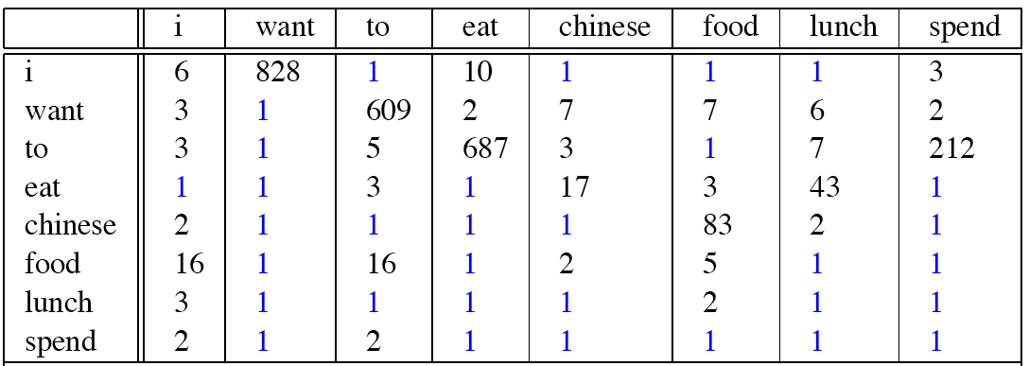
Berkeley Restaurant Corpus: Laplace smoothed bigram counts

Slide 66
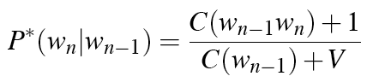
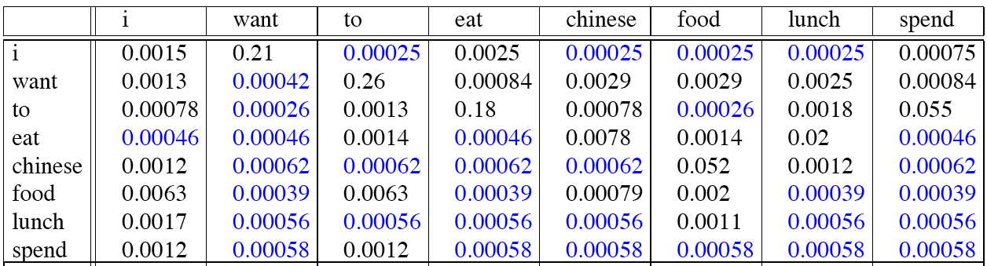
Laplace-smoothed bigrams

Slide 67
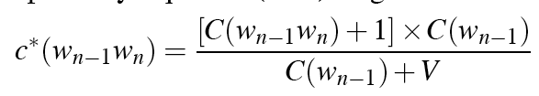
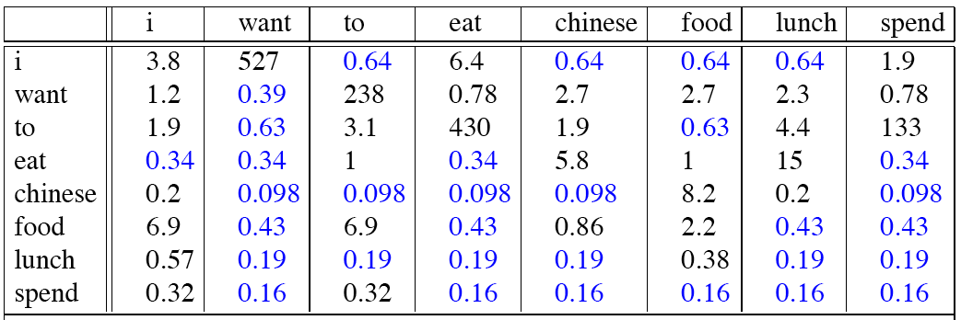
Reconstituted counts

Slide 68
Compare with raw bigram counts
Notes:
C(want to) went from 608 to 238, P(to|want) from .66 to .26!
Discount d= c*/c
d for “chinese food” =.10!!! A 10x reduction

Slide 69
Add-1 estimation is a blunt instrument
So add-1 isn’t used for N-grams:
Generally we use interpolation or backoff instead
But add-1 is used to smooth other NLP models
For text classification
In domains where the number of zeros isn’t so huge.

Slide 70
Backoff and Interpolation
Sometimes it helps to use less context
Condition on less context for contexts you know less about
Backoff:
use trigram if you have good evidence,
otherwise bigram, otherwise unigram
Interpolation:
mix unigram, bigram, trigram
Interpolation works better

Slide 71
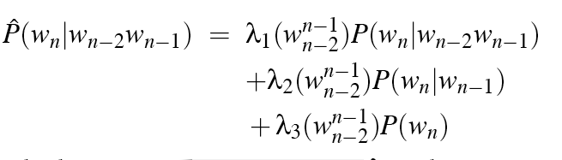
Linear Interpolation
Simple interpolation
Lambdas conditional on context:

Slide 72
How to set λs for interpolation?
Use a held-out corpus
Choose λs to maximize probability of held-out data:
Fix the N-gram probabilities (on the training data)
Then search for λs that give largest probability to held-out set
Training Data
Held-Out Data
Test
Data

Slide 73
Backoff
Suppose you want:
P(pancakes| delicious soufflé)
If the trigram probability is 0, use the bigram
P(pancakes| soufflé)
If the bigram probability is 0, use the unigram
P(pancakes)
Complication: need to discount the higher-order ngram so probabilities don't sum higher than 1 (e.g., Katz backoff)

Slide 74
Stupid Backoff
Backoff without discounting (not a true probability)

Slide 75
N-gram Language Modeling
Interpolation and Backoff

